Slide 1

Containers
19CSE201 Advanced Programming

Slide 2
Containers in STL
Containers Library in STL gives Containers, which in simplest words, can be described as the objects used to contain data.
Containers help to implement and replicate simple and complex data structures very easily like arrays, list, trees, associative arrays and many more.
The containers are implemented as generic class templates, means that a container can be used to hold different kind of objects and they are dynamic in nature!

Slide 3
char
int
float
….etc
Container
GenericType Data Structures

Slide 4
Classification of Containers
Containers are classified into four categories :
Sequence containers : Used to implement data structures that are sequential in nature like arrays(array) and linked list(list).
Associative containers : Used to implement sorted data structures such as map, set etc.
Unordered associative containers : Used to implement unsorted data structures.
Container adaptors : Used to provide different interface to the sequence containers.

Slide 5
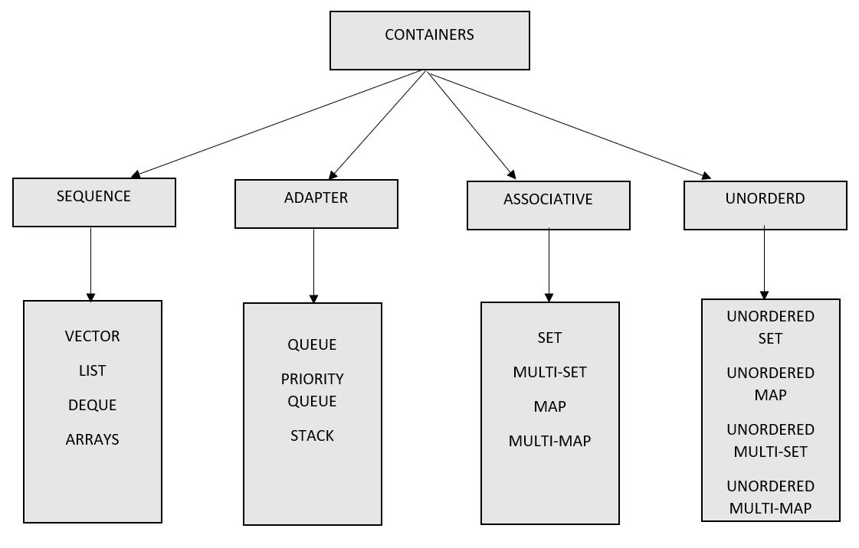
Container types in each category

Slide 6
Sequence containers and Container adapters
Sequence container
Name | Description
array | Fixed array size
Vector | Dynamic size array
deque | Double ended queue
forward_list | Singly linked list
list | Doubly linked list
Container Adapters
Name | Description
Stack | stack
Queue | FIFO queue
Priority-queue | Priority queue

Slide 7
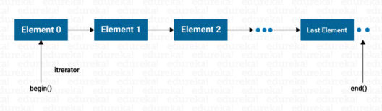
Sequence Container- Array
Container properties :
Sequence
Elements in sequence containers are ordered in a strict linear sequence.
Individual elements are accessed by their position in this sequence.
Contiguous storage
The elements are stored in contiguous memory locations, allowing constant time random access
to elements. Pointers to an element can be offset to access other elements.
Fixed-size aggregate
The container uses implicit constructors and destructors to allocate the required space
statically. Its size is compile-time constant. No memory or time overhead
template < class T, size_t N > class array;
SYNTAX of array container:
array<object_type, array_size> array_name;
array<int, 4> even_numbers = { 2, 4, 6, 8 };
https://www.cplusplus.com/reference/array/array/

Slide 8
Member functions of Array
Iterators
begin, end
Capacity
Size, max_size, empty
Element access
Operator [], at, front, back, data
Modifiers
Fill, swap

Slide 9
Sequence Container - Vector
Amrita | Sumesh | Anand | Akshay
Initially the vector is blank, as it has no data , but as you add data , it grows
Container properties :
Sequence
Elements in sequence containers are ordered in a strict linear sequence.
Individual elements are accessed by their position in this sequence.
Contiguous storage
The elements are stored in contiguous memory locations, allowing constant time random access
to elements. Pointers to an element can be offset to access other elements.
Dynamic-size aggregate
The container uses implicit constructors and destructors to allocate the required space
statically. Its size is compile-time constant. No memory or time overhead
vector< object_type > vector_name;
SYNTAX of Vector container:
std::vector<int> my_vector;
std::vector<string> v {“Amrita" ,“Sumesh" ,“Anand" ,“Akshay"};
https://www.cplusplus.com/reference/vector/vector/

Slide 10
Member functions of Vector
Iterators
begin, end
Capacity
Size, empty, capacity(),resize()
Element access
at, front(), back()
Modifiers
push_back(), insert(), pop_back(), erase(), swap(), clear()

Slide 11
Container Adaptors
The Sequential and Associative container classes form the group called first-class containers used to address the simple problem of efficiently storing and retrieving objects as needed at runtime generically.
Another type of container class which can not only store elements efficiently but also put some constraints in the storage and retrieval process of the elements. These types of containers are called container adapters.
The container adapter provide a different interface for sequential containers.
The C++ Standard Library implements class templates such as stack, queue, and priority_queue as a container that puts constraints on the process of storage and retrieval of elements.
It does not support iterators.
Adapter container classes provide functions like push and pop that insert and retrieve an element into the storage, respectively.

Slide 12
Stack Container
The class called stack is an implementation of the stack data structure where insertion and retrieval of elements occurs according to the LIFO (last-in-first-out) manner.
Defined in the header file <stack>
Syntax
stack<object_type> stack_name;

Slide 13
Basic functions in stack
empty() – Returns whether the stack is empty.
size() – Returns the size of the stack.
top() – Returns a reference to the top most element of the stack.
push(g) – Adds the element ‘g’ at the top of the stack.
pop() – Deletes the top most element of the stack

Slide 14
Sample program
#include <iostream>
#include <stack>
using namespace std;
int main() {
stack<int>s;
s.push(56);
s.push(67);
s.push(24);
s.push(12);
s.push(90);
cout<<"Top of the stack:"<<s.top()<<endl;
cout<<"Size of the stack:"<<s.size()<<endl;
cout<<"Stack elements are:"<<endl;
while (!s.empty()) {
cout << ' ' << s.top();
s.pop();
}
cout<<endl;
cout<<"Stack empty!";
}

Slide 15
Queue Container
Queues are a type of container adaptors which operate in a first in first out (FIFO) type of arrangement. Elements are inserted at the back (end) and are deleted from the front.
Defined in the header file <queue>
Syntax
queue< object_type > queue_name;

Slide 16
Basic functions in queue
empty() – Returns whether the queue is empty.
size() – Returns the size of the queue.
front() -Returns a reference to the first element of the queue.
back() -Returns a reference to the last element of the queue.
push(g) -Adds the element ‘g’ at the end of the queue.
pop() -Deletes the first element of the queue.

Slide 17
Sample program
#include <iostream>
#include <queue>
using namespace std;
int main() {
queue<string>q;
q.push("A");
q.push("R");
q.push("K");
q.push("J");
q.push("I");
cout<<"Front:"<<q.front()<<endl;
cout<<"Size of the queue:"<<q.size()<<endl;
cout<<"Back:"<<q.back()<<endl;
cout<<"Queue elements are:"<<endl;
while (!q.empty()) {
cout << ' ' << q.front();
q.pop();
}
cout<<endl;
cout<<"Queue empty!";
}

Slide 18
Priority queue Container
Priority queue is similar to normal queue except the element removed from the queue is always the greatest among all the elements in the queue.
It simulates the max heap.
Defined in the header file <queue>
Syntax
priority_queue<int> pq_name;

Slide 19
Basic functions in priority queue
empty() – Returns whether the priority queue is empty.
size() – Returns the size of the priority queue.
push(g) -Inserts a new element into the priority queue.
pop() -It removes the top element from the queue which has the highest priority.
top()-It returns the topmost element in the priority queue.

Slide 20
Sample program
#include <iostream>
#include <queue>
using namespace std;
int main() {
priority_queue<int>q;
q.push(59);
q.push(42);
q.push(32);
q.push(34);
q.push(58);
cout<<"Size of the p_queue:"<<q.size()<<endl;
cout<<"P_Queue elements are:"<<endl;
while (!q.empty()) {
cout << ' ' << q.top();
q.pop();
}
cout<<endl;
cout<<"P_Queue empty!";
}

